Slide 1
Parch & Posey: Database EDA

Slide 2
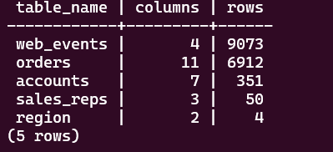
DATABASE OVERVIEW
Insight: Shows all tables with their row counts – Web Events is largest table.

Slide 3
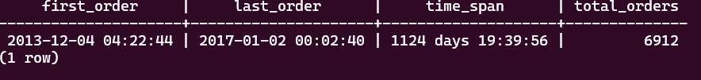
ORDERS DATE RANGE
Insight: Complete date range of all orders showing business duration

Slide 4
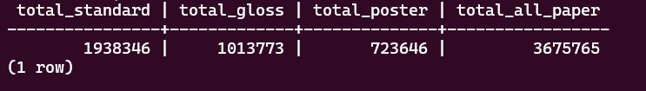
ORDERS BY PAPER TYPE
Insight: Standard paper dominates sales, gloss and poster are smaller segments

Slide 5
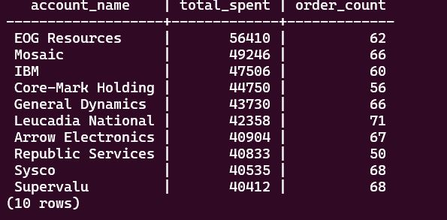
TOP 10 ACCOUNTS BY SPEND
Insight: EOG Resources is the top customer that contributes significantly to total revenue

Slide 6
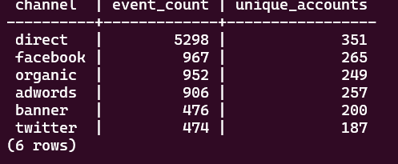
SALES CHANNEL PERFORMANCE
Insight: Direct and Facebook channels drive most web traffic.

Slide 7
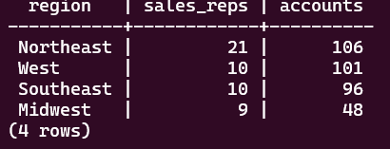
REGIONAL DISTRIBUTION
Insight: Northeast region has most accounts and sales reps.

Slide 8
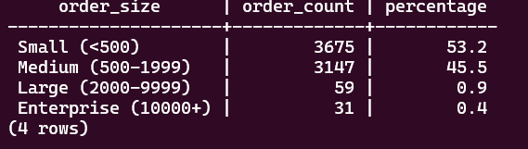
ORDER SIZE DISTRIBUTION
Insight: Majority of orders size are Small.

Slide 9
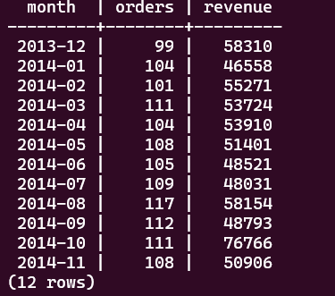
MONTHLY ORDER TREND
Insight: Shows monthly orders and revenue with the highest revenue form 2013-12 but the highest order from 2014-08.

Slide 10
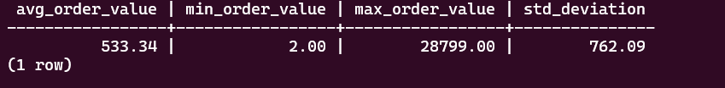
AVERAGE ORDER VALUE
Insight: Wide range of order values with high standard deviation

